Slide 9
By Category

Slide 10
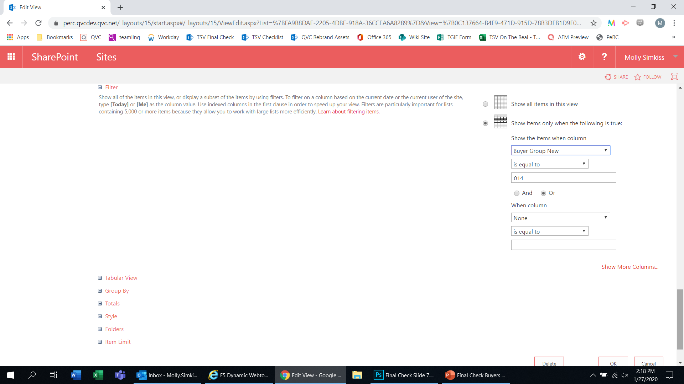
The same applies for Buyer Codes: just select Buyer Group New from the dropdown (see right), enter your Buyer Code, and press OK; then, follow the instructions on the previous slide to set up your notifications

Slide 11
Individual Posts

